Slide 1
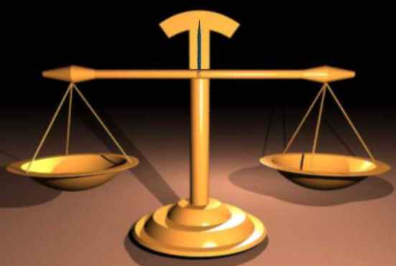
Solve r + 16 = -7
Think of this equation as a balance scale.
r + 16
=
-7
Whatever you do to one side has to be done to the other to keep it balanced!

Slide 2
Solve r + 16 = -7
Draw “the river” to separate the equation into 2 sides
Subtract 16 from both sides
Simplify vertically
Check your answer by substituting your answer back into the problem
- 16 -16
r = -23
-23 + 16 = -7

Slide 3
Solve x + 2 = -3 Get the variable by itself. What is your first step?
Add 2 to both sides
Subtract 2 from both sides
Add 3 to both sides
Subtract 3 from both sides
Answer Now

Slide 4
Solve x + 2 = -3
Draw “the river” to separate the equation into 2 sides
Subtract 2 from both sides
Simplify vertically
Check your answer by substituting your answer back into the problem
- 2 - 2
x = -5
-5 + 2 = -3
Be sure to check your work!!
There is no reason why you should miss a problem!

Slide 5
Solve 8 = m - 3
m = 5
m = 11
m = 24
m = 8/3
Answer Now

Slide 6
When solving equations, we want to eliminate double signs.
y + (-3) = 8
is rewritten as
y – 3 = 8
p – (-5) = 6
is rewritten as
p + 5 = 6
As a general rule, replace “+ (- )” with “–” and “– (- )” with “+”. This will make things less confusing in the future!

Slide 7
Solve y + (-3) = 7
Draw “the river” to separate the equation into 2 sides
Eliminate the double sign
Add 3 to both sides
Simplify vertically
Check your answer by substituting your answer back into the problem
y – 3 = 7
+ 3 +3
y = 10
10 – 3 = 7

Slide 8
Solve. -x - (-2) = 1
Draw “the river” to separate the equation
into 2 sides
Eliminate the double sign
Subtract 2 from both sides
4. Simplify vertically
5. We haven’t gotten x by itself. If we read this aloud, it is “the opposite of x equals -1”. What would x be equal?
6. Check your answer
-x + 2 = 1
- 2 - 2
-x = -1
x = 1
-(1) + 2 = 1

Slide 9
Solve -y – (-3) = 7
y = 10
y = 4
y = -10
y = -4
Answer Now

Slide 10
Solve -5t = 60
Draw “the river” to separate the equation into 2 sides
Divide both sides by -5
Simplify
Check your answer
-5 -5
t = -12
-5(-12) = 60

Slide 11
Solve 15 = 6n
Draw “the river”
Divide both sides by 6
Simplify
Check your answer
6 6
2.5 = n
15 = 6(2.5)

Slide 12
3) Solve -3v = -129
v = -126
v = -43
v = 43
v = 126
Answer Now

Slide 13
Solve
Draw “the river”
Clear the fraction – multiply both sides by 4
Simplify
Check your answer
4 · ·4
x = -48

Slide 14
Solve = 18
Draw “the river”
Clear the fraction – multiply both sides by 3
Simplify
Divide both sides by 2
Simplify
Check your answer
3 · = 18 · 3
2x = 54
2 2
x = 27

Slide 15
6) Which step clears the fraction in
Multiply by 3
Multiply by 5
Multiply by -12
Multiply by -5
Answer Now

Slide 16
Solve
b = -56
b = -14
b = 14
b = 56
Answer Now

Slide 17
To solve two-step equations, undo the operations by working backwards.
Example:
Ask yourself,
What is the first thing I need to undo?
What is the second thing?
PEMDAS
Pemdas backwards

Slide 18
Solve 2x - 1 = -3
Draw “the river”
Add 1 to both sides
Simplify
Divide both sides by 2
Simplify
Check your answer
+ 1 + 1
2x = -2
2 2
x = -1
2(-1) - 1 = -3
-2 – 1 = -3

Slide 19
Solve
Draw “the river”
Add 4 to both sides
Simplify
Clear the fraction -Multiply both sides by 3
Simplify
Check your answer
+ 4 + 4
3 · · 3
x = 36
12 – 4 = 8

Slide 20
Solve 3y – 1 = 8
y = 3
y = -3
y =
y =
Answer Now

Slide 21
Solve
d = -7
d = -19
d = -17
d = 17
Answer Now

Slide 22
Solve 5z + 16 = 51
z = -35
z = -7
z = 35
z = 7
Answer Now

