Slide 1
Default text (Verdana 24 pt)
Variation
Default shape
Dark blue outline, 3 pt weight
Light blue fill
Black text, centered
Verdana 24 pt
Variation
Variation
(not exhaustive)

Slide 2
Objective: You will be able to determine if a number is a perfect cube and to find the cube root of a number that is a perfect cube.

Slide 3
Perfect Cubes and Cube Roots
Remember
A cube is a three dimensional prism with 6 square faces; so all sides are congruent and all angles are right angles.

Slide 4
Perfect Cubes and Cube Roots
Squares and Cubes:
Similarities
- All sides congruent
- All angles 90 degrees
Differences:
- Square is 2 dimensional
- Cube is 3 dimensional that number’s square root.

Slide 5
Perfect Cubes and Cube Roots
Remember
A number is a perfect square if you can take that many 1 x 1 unit squares and form them into a square. The side length of the square you form is that number’s square root.

Slide 6
Perfect Cubes and Cube Roots
A number is a if you can take that many
and form them into a . The side length of the you form is that number’s .
perfect square
perfect cube
1 x 1 x 1 unit cubes
1 x 1 unit squares
cube
square
square
cube
cube root
square root

Slide 7
Perfect Cubes and Cube Roots
A number is a perfect cube if you can take that many 1 x 1 x 1 unit cubes and form them into a cube. The side length of the cube you form is that number’s cube root.is that number’s square root.

Slide 8
Perfect Cubes and Cube Roots
Is 8 a perfect cube?
that number’s square root.

Slide 9
Perfect Cubes and Cube Roots
that.

Slide 10
Perfect Cubes and Cube Roots
that.

Slide 11
Perfect Cubes and Cube Roots
8 is a perfect cube and its cube root is 2

Slide 12
Perfect Cubes and Cube Roots
Is 5 a perfect cube?

Slide 13
Perfect Cubes and Cube Roots
Is 5 a perfect cube?

Slide 14
Perfect Cubes and Cube Roots
Three Dimensions
Perfect Cube
Volume

Slide 15
Perfect Cubes and Cube Roots
Perfect Cube: 8 Cube Root 2
Volume: 8 units³ Side Length: 2 units

Slide 16
Perfect Cubes and Cube Roots
Side Length | Volume Operation | Volume | Perfect Cube
2 units | 2 x 2 x 2 | 8 units³ | 8

Slide 17
Perfect Cubes and Cube Roots
Perfect Cube: Cube Root
Volume: units³ Side Length: units

Slide 18
Perfect Cubes and Cube Roots
Side Length | Volume Operation | Volume | Perfect Cube
1 unit | 1 x 1 x 1 | 1 units³ | 1
2 units | 2 x 2 x 2 | 8 units³ | 8

Slide 19
Perfect Cubes and Cube Roots
Perfect Cube: Cube Root
Volume: units³ Side Length: units

Slide 20
Perfect Cubes and Cube Roots
Side Length | Volume Operation | Volume | Perfect Cube
1 unit | 1³ | 1 units³ | 1
2 units | 2³ | 8 units³ | 8
3 units | 3³ | 27 units³ | 27

Slide 21
Perfect Cubes and Cube Roots
Side Length | Volume Operation | Volume | Perfect Cube
1 unit | 1³ | 1 units³ | 1
2 units | 2³ | 8 units³ | 8
3 units | 3³ | 27 units³ | 27
4 units

Slide 22
Perfect Cubes and Cube Roots
Side Length | Volume Operation | Volume | Perfect Cube
1 unit | 1³ | 1 units³ | 1
2 units | 2³ | 8 units³ | 8
3 units | 3³ | 27 units³ | 27
4 units | 4³

Slide 23
Perfect Cubes and Cube Roots
Side Length | Volume Operation | Volume | Perfect Cube
1 unit | 1³ | 1 units³ | 1
2 units | 2³ | 8 units³ | 8
3 units | 3³ | 27 units³ | 27
4 units | 4³ | 64 units³

Slide 24
Perfect Cubes and Cube Roots
Side Length | Volume Operation | Volume | Perfect Cube
1 unit | 1³ | 1 units³ | 1
2 units | 2³ | 8 units³ | 8
3 units | 3³ | 27 units³ | 27
4 units | 4³ | 64 units³ | 64

Slide 25
Perfect Cubes and Cube Roots
Side Length | Volume Operation | Volume | Perfect Cube
1 unit | 1³ | 1 units³ | 1
2 units | 2³ | 8 units³ | 8
3 units | 3³ | 27 units³ | 27
4 units | 4³ | 64 units³ | 64
S units | S³ | S³ units³ | S³

Slide 26
Perfect Cubes and Cube Roots
Side Length of cube | Volume Operation | Volume of cube | Perfect Cube
1 unit | 1³ | 1 units³ | 1
2 units | 2³ | 8 units³ | 8
3 units | 3³ | 27 units³ | 27
4 units | 4³ | 64 units³ | 64
S units | S³ | S³ units³ | S³
10 units

Slide 27
Perfect Cubes and Cube Roots
Side Length of cube | Volume Operation | Volume of cube | Perfect Cube
1 unit | 1³ | 1 units³ | 1
2 units | 2³ | 8 units³ | 8
3 units | 3³ | 27 units³ | 27
4 units | 4³ | 64 units³ | 64
S units | S³ | S³ units³ | S³
10 units | 10³

Slide 28
Perfect Cubes and Cube Roots
Side Length of cube | Volume Operation | Volume of cube | Perfect Cube
1 unit | 1³ | 1 units³ | 1
2 units | 2³ | 8 units³ | 8
3 units | 3³ | 27 units³ | 27
4 units | 4³ | 64 units³ | 64
S units | S³ | S³ units³ | S³
10 units | 10³ | 1000 u³

Slide 29
Perfect Cubes and Cube Roots
Side Length of cube | Volume Operation | Volume of cube | Perfect Cube
1 unit | 1³ | 1 units³ | 1
2 units | 2³ | 8 units³ | 8
3 units | 3³ | 27 units³ | 27
4 units | 4³ | 64 units³ | 64
S units | S³ | S³ units³ | S³
10 units | 10³ | 1000 u³ | 1000

Slide 30
Perfect Cubes and Cube Roots
Square Root
$√$

Slide 31
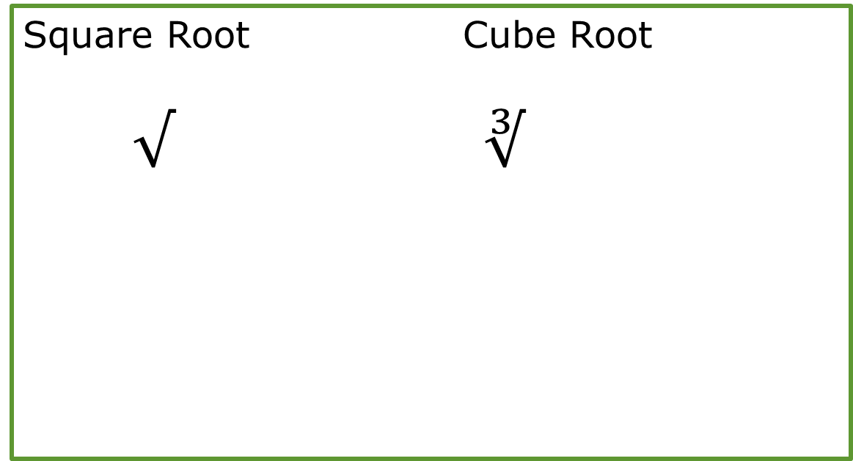
Perfect Cubes and Cube Roots
Square Root Cube Root
$√$ $∛$

Slide 32
Perfect Cubes and Cube Roots
Square Root Cube Root
$√$ $∛$

Slide 33
Perfect Cubes and Cube Roots
Square Root Cube Root
$√$ $∛$

Slide 34
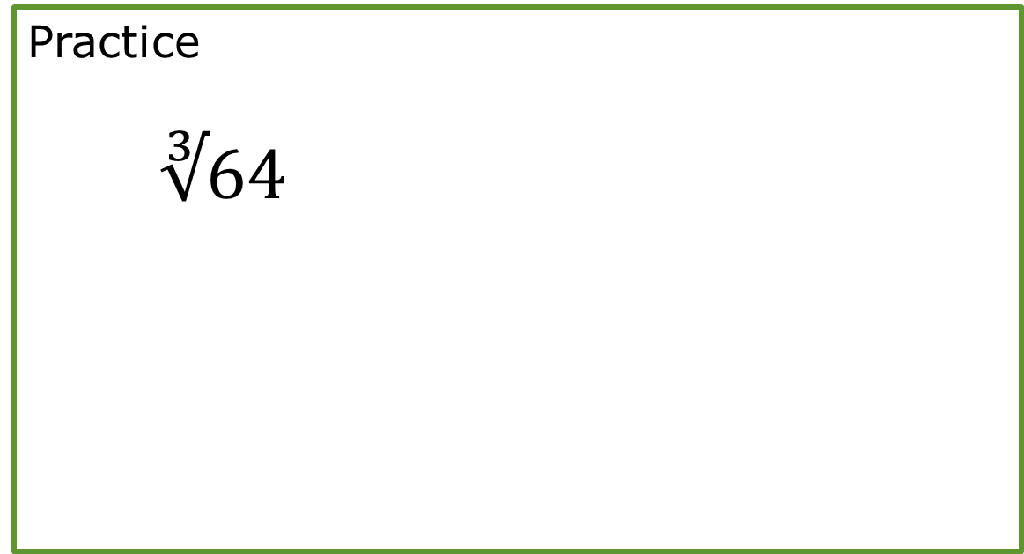
Perfect Cubes and Cube Roots
Practice
$∛64$

Slide 35
Perfect Cubes and Cube Roots
Practice
Is 827 a perfect cube?

Slide 36
Conclusion: You can now determine if a number is a perfect cube and find the cube root of a number that is a perfect cube.

